Slide 1
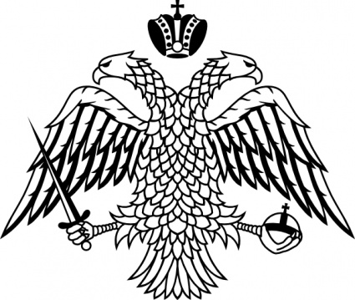
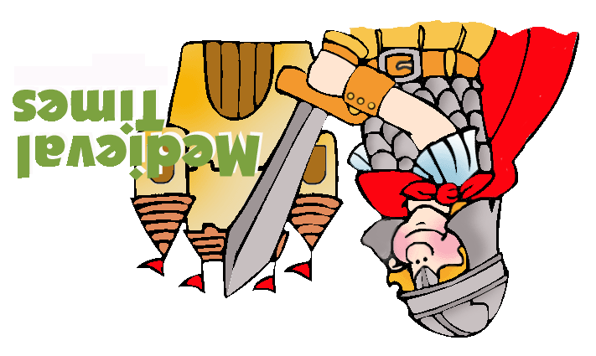
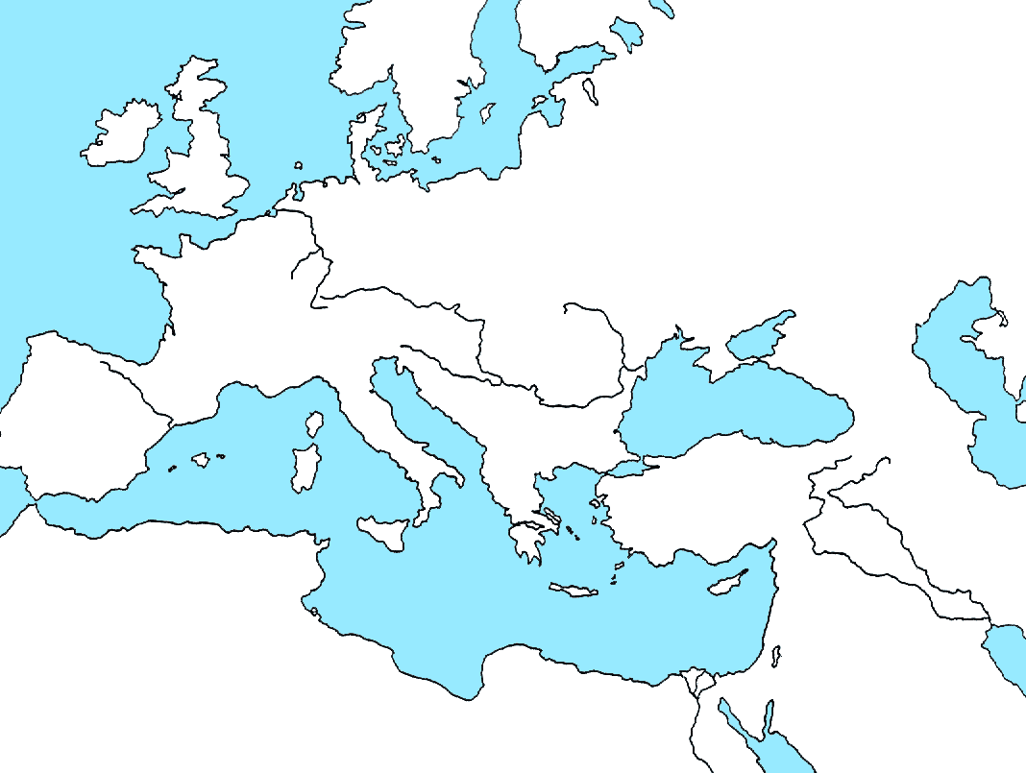
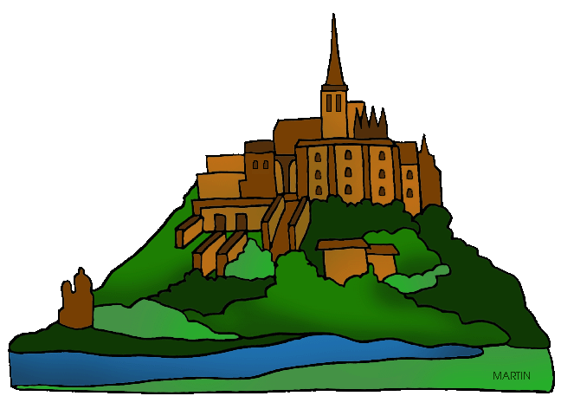
passport
Unit 2 – Medieval Europe
California Standard 761
Review Passport
Name ________________________________
Date ________________ Period ___________
Medieval Europe and the Middle Ages
Geography
Catholic Church
(14) Who led the Catholic Church? _______________________________________ (15) How did the Catholic Church influence education?______________ _________________
______________________________________
(16) How did the Catholic Church influence art?
a. The Pope created most of the art
b. the Church forbid art to be created at all
c. most art of the Middle Ages was about religious subjects
d. the Catholic Church gave the power to the king to create as many art pieces as possible
Spain is a Peninsula. Southern Europe had many peninsulas.
What is a peninsula?
Because they lived on a peninsula, how did people live?
Northern Europe was full of plains.
What is a plain?
Because they lived on plains, how did people live?

Slide 2
After Rome fell, Europe was divided into many Kingdoms. What was one political problem because of this?
What was the purpose of Feudalism?
______________________________________ _______________________________________
(5) Write the names of each person in the Feudal System. Write their MAIN ROLE.
The Bubonic Plague
(10) True or False
The population of Europe decreased by more millions of people because of the Bubonic Plague_______
What was the Bubonic Plague and what caused it?. ___________________________________
______________________________________
(12) The Bubonic Plague killed many workers. What did this mean that fort he workers who were left? (what did they do?______________________________________ ___
_____________________________________
(13) What happened in the towns as a result of the plague? Why did this happen, do you think?
______________________________________
______________________________________
______________________________________
Choose 1 person and describe their position with
detail.
Feudalism
Kings Vs. Popes
The Magna Carta
What happened between Charlemagne and Pope Leo III?___________________________ _____________________________________________________________________________________________________________________
What happened between King Henry IV and Pope Gregory VII?
_______________________________________ _____________________________________________________________________________________________________________________
(7) As a result of both these events, who gained power and who lost power?
_______________________________________ _______________________________________
_______________________________________ _______________________________________
Which King signed the Magna Carta? __________
What was the purpose of the Magna Carta? _____________________________________________________________________________________
What is the law of Habeas Corpus?
_______________________________________ _______________________________________
What is Parliament?
_______________________________________ _______________________________________
The Magna Carta said that everyone has the right to a fair trial. What does that mean?
_______________________________________ ________________________________________According to the Magna Carta, who had to follow the laws? ________________________________________

