Slide 1
Do Now
Have out your homework so you can also get a stamp there, too.

Slide 2
Agenda
Do Now: 10 minutes
Announcements: 3 minutes
Unit 2 Introduction: 5 minutes
Medieval Europe: 30 minutes
Wrap up: 2 minutes

Slide 3
Announcements
Unit 1 Assessment corrections due today

Slide 4
unit 2: Medieval Europe
now let’s begin…

Slide 5
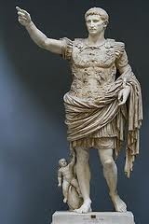
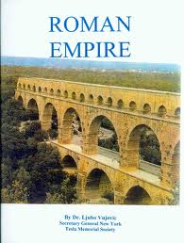
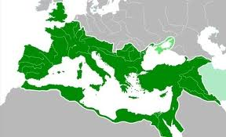
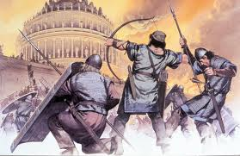
Rome was the strongest empire in the world
Until Barbarians invaded and Rome collapsed.

Slide 6
Predict: What do you think happened in Western Europe AFTER the Fall of the Roman Empire?

Slide 7
Reality: What happened in Western Europe after the fall of the Roman Empire?
Turn to page 20.
Use the first paragraph to complete the reading notes
Think about:
What happened after Rome fell?
What was the political problem?
4. Complete the “in your own words”

Slide 8
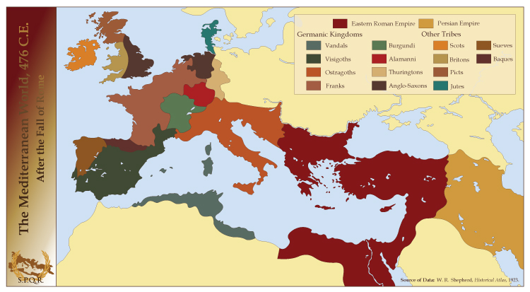
After Rome declined, Europe was divided into kingdoms that were often at war.
Western Europe was in chaos, because there was not a system of government.

Slide 9
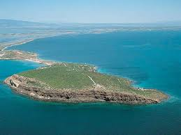
How would you live in a place surrounded by water?
-How would you get your food?
-How would you contact other people?
-How would you make money?

Slide 10
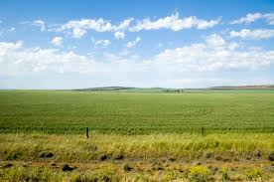
How would you live in a place with large fields and a good amount of rain?
-How would you get your food?
-How would you make money?

Slide 11
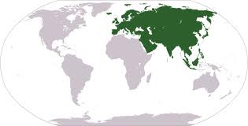
Vocabulary:
Eurasia: the landmass that includes Europe and Asia

Slide 12
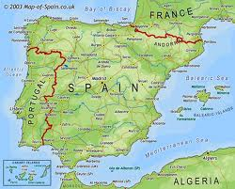
Peninsula: land surrounded on 3 sides by water (Example: ____________)
Plains: large grassy areas that are good for farming

Slide 13
Check your Understanding:
How does a peninsula affect life of the people who live there?

Slide 14
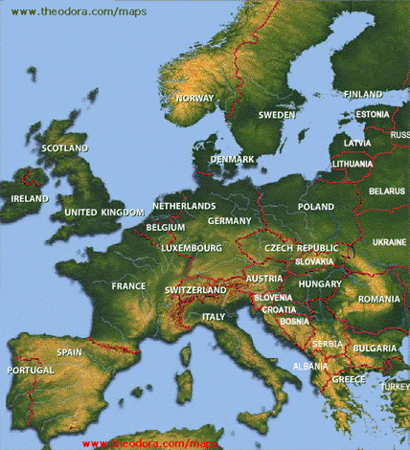
How did Geography affect life in Northern and Southern Europe?

Slide 15
 | Geography | How would YOU live? | Class language
Northern Europe
Southern Europe
Because people lived near plains, they farmed a variety of crops.
Because people lived near the water, they became great seafarers and traders.

Slide 16
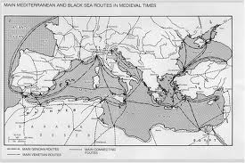
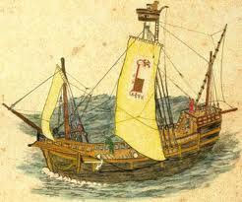
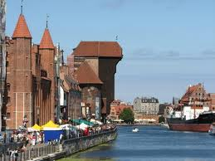
Seafarers

Slide 17
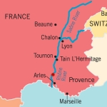
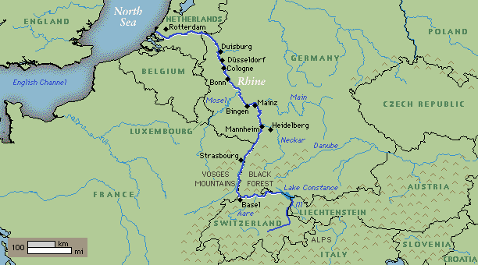
European Cities
Most cities are located near___________...Why?

Slide 18
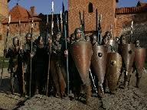
Feudalism was created as a way to organize the different kingdoms.
Everyone in the kingdom had a role, or job, and everyone was loyal to their position.
After the fall of the Roman Empire there was a lack of central government.
Europe was divided into small kingdoms.
Warlords controlled these kingdoms, fighting amongst each other for land and power.

Slide 19
Feudalism was an organizational system for land and people.
During feudal times, each person had a role to perform that helped society function.
People were bound to be loyal and honor their duty and their superiors.

Slide 20
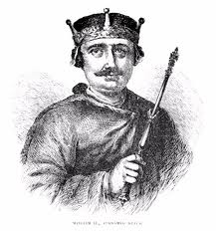
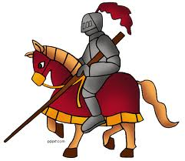
Feudalism: A system of political organization in which everyone had a specific role or job

Slide 21
How did the peninsulas of southern Europe affect the way people lived?
a. People on the peninsulas raised goats and sheep.
b. People on the peninsulas grew grapes and olives.
c. People on the peninsulas became great seafarers and traders.
d. People on the peninsulas became farmers.

